Slide 1
Chains of Blood
By Cory Morales, Jorge Benavides, Andrew Lee

Slide 2
Progress Report
Game Description:
Metriodvania style
2D side scroller
Medieval setting
Levelling/ powerup system
Achievement system
Main Goals
Collect Gold
Defeat main boss

Slide 3
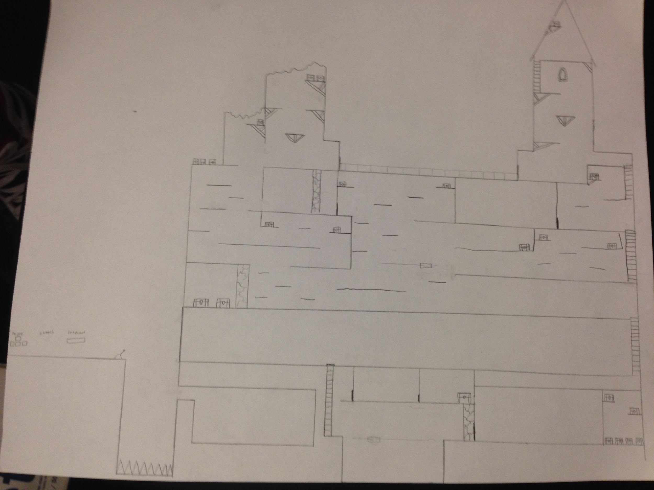
Progress Report cont.
Map sketched
Platforming program operational

